Slide 1
Topic: Census and Surveys EQ: What are the different types of Sampling Methods?
Put new topic in contents page

Slide 2
Learning Intentions
Students will be able to
Census
3.4.1 investigate the procedure for conducting a census
3.4.2 investigate the advantages and disadvantages of conducting a census
Surveys
3.4.3 understand the purpose of sampling to provide an estimate of population values when a census is not used
3.4.4 investigate the different kinds of samples, for example, systematic samples, self‐selected samples, simple random samples
3.4.5 recognise the advantages and disadvantages of these kinds of samples; for example, comparing simple random samples with self‐selected samples

Slide 3
24
7
30
Census and Surveys
Date
EQ – What are the different types of Sampling Methods?
Collecting Information
To collect information, a group of people are surveyed. This process is called taking a sample.
To collect information about a whole population, all people are surveyed. This is called a census.
Every 5 years the Australian Bureau of Statistics conducts a census. It occurs in each year ending with a 1 or a 6.
Baldivis: https://quickstats.censusdata.abs.gov.au/census_services/getproduct/census/2016/quickstat/SSC50054?opendocument

Slide 4
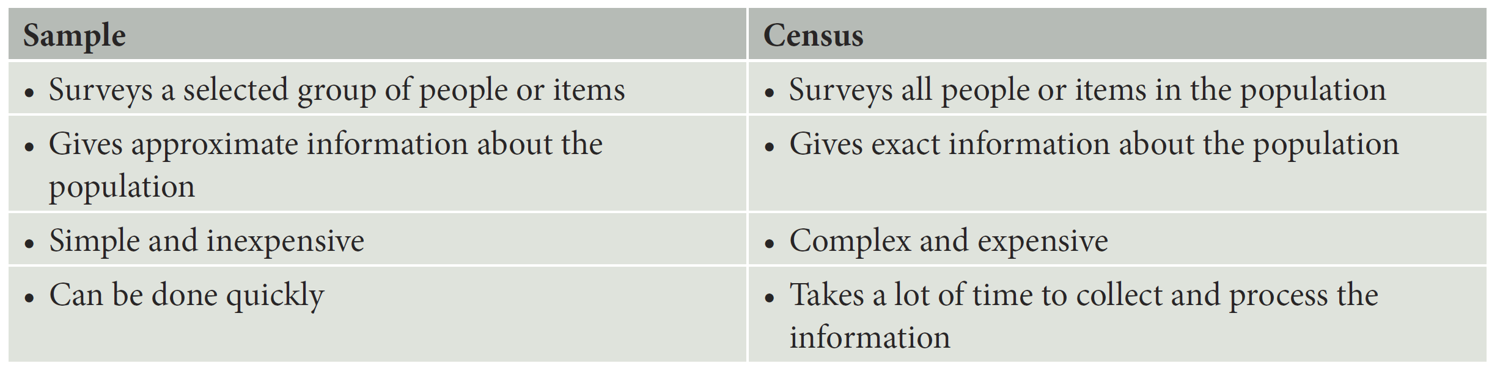
24
7
30
Census and Surveys
Date
EQ – What are the different types of Sampling Methods?
Sample Vs Census
Pros and cons
No need to write but glue in “extra notes” worksheet

Slide 5
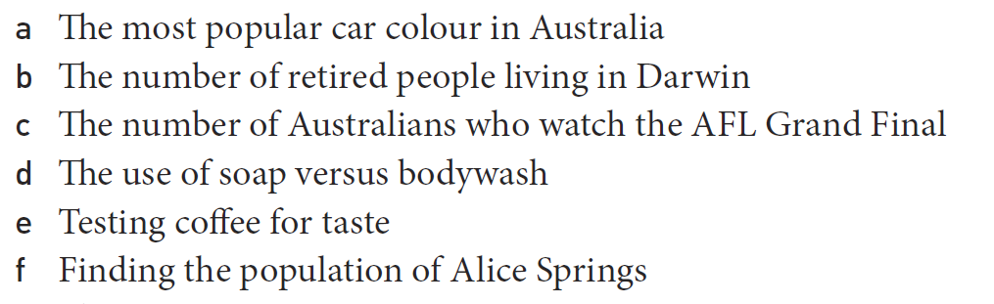
Practice
a. Sample
b. Census
c. Sample
d. Sample
e. Sample
f. Census

Slide 6


Slide 7
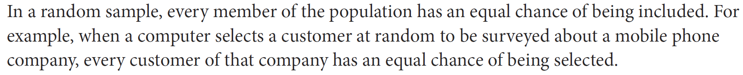
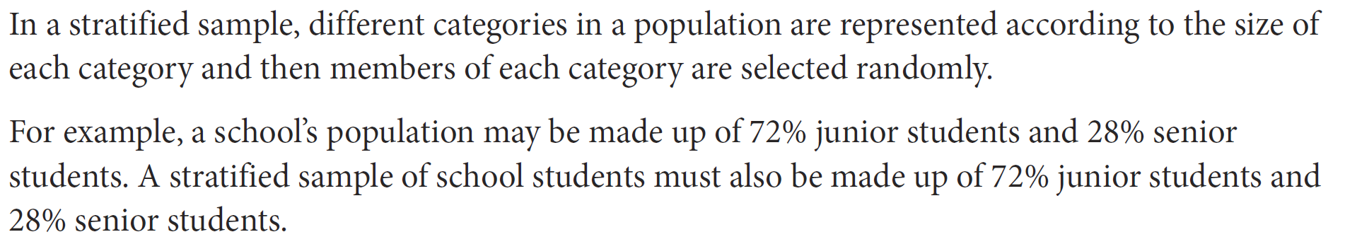
24
7
30
Census and Surveys
Date
EQ – What are the different types of Sampling Methods?
Random Sample
Stratified Sample

Slide 8
24
7
30
Census and Surveys
Date
EQ – What are the different types of Sampling Methods?
Systematic Sample
Self Selected Sample

Slide 9
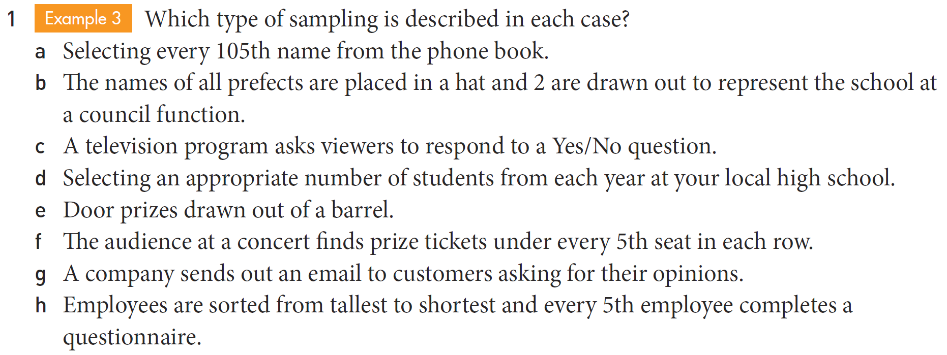
Practice
a. Systematic b. random c. self-selected d. stratified e. random f. systematic
g. self-selected h. systematic

Slide 10
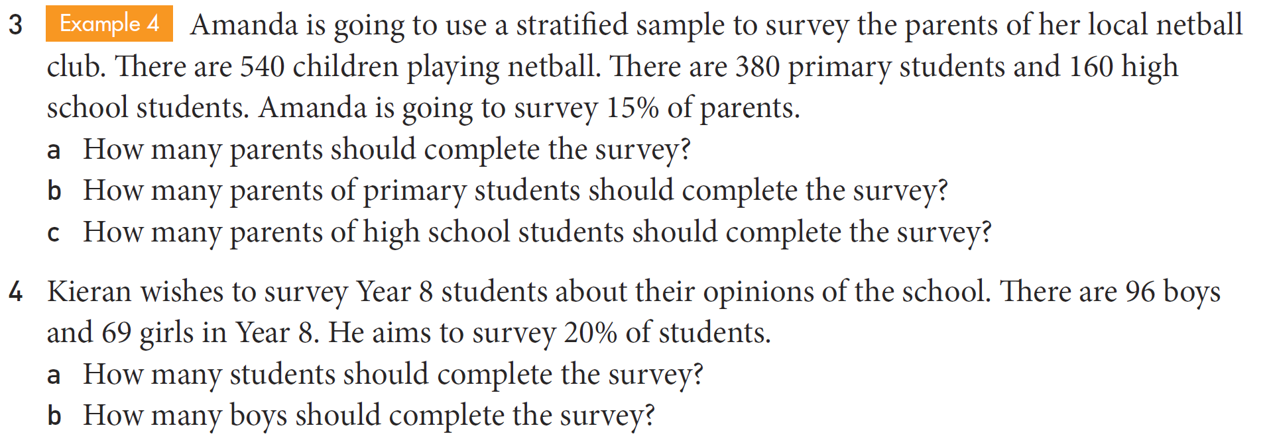
Task

Slide 11
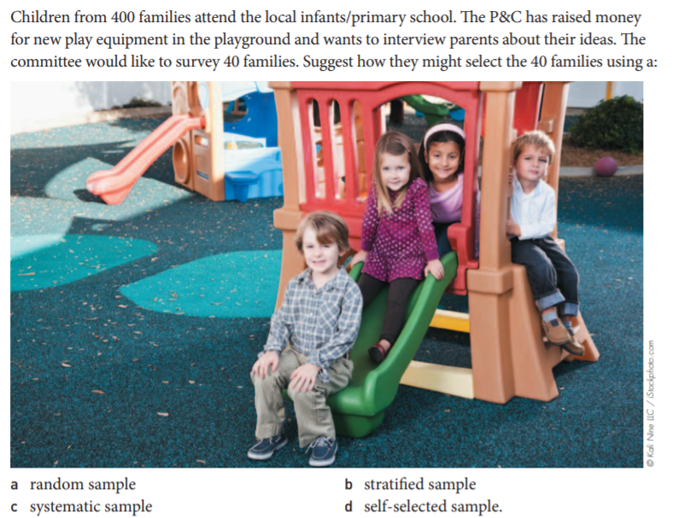
EXIT PASS- in pairs with butcher’s paper

Slide 12
Crunch and shoot- Practice time

Slide 13
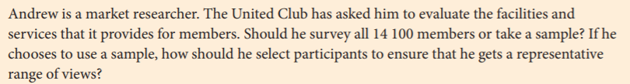
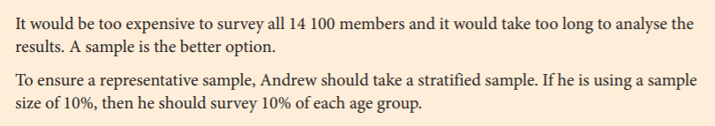
24
7
30
Topic: Census and Surveys
Date
EQ – What are the different types of Sampling Methods?
Warm Up/Teacher example (4 marks):
Crunch and Shoot.
-Work in pairs
- Use butcher’s paper
Let’s discuss why there are 4 marks.
Justify/Explain your reasoning

Slide 14
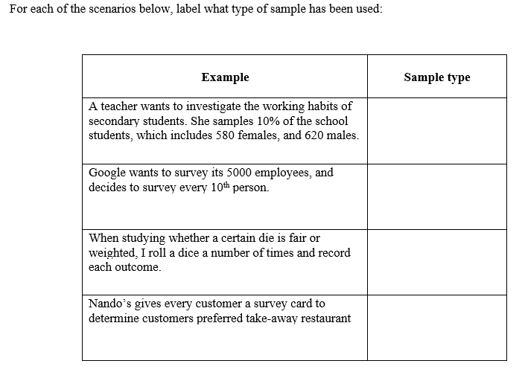
24
7
30
Topic: Census and Surveys
Date
EQ – What are the different types of Sampling Methods?
Round 1: 4 marks
Crunch and Shoot.

Slide 15
24
7
30
Topic: Census and Surveys
Date
EQ – What are the different types of Sampling Methods?
Round 2: 3 marks
Look at the marks to see how much info you need to provide
Crunch and Shoot.
Gilbert decides that he wants to conduct a stratified sample of 30% of the school population.
There are 1265 students at the school, which includes 572 male students and 693 female students.
Calculate how many students he should survey, and how many males and females should be surveyed

Slide 16
24
7
30
Topic: EST Preparation
Date
EQ: Types of samples?
Solutions:
Round 1: Stratified, systematic, random, self-selected
Round 2: 171-172 males, 207-208 females. So all up between 378- 380 students in total
Crunch and Shoot.
-Work in pairs
- Use butcher’s paper

